Slide 1

EARN Maryland

Slide 2
What is EARN Maryland?
Established in 2014, EARN is a state-funded program.
EARN builds upon the Moore-Miller administration’s priorities of connecting Marylanders to jobs while increasing the State’s economic competitiveness.

Slide 3
What is EARN Maryland Slide 2
Addresses workforce needs by focusing on industry sector strategies that seek long-term solutions to sustained skills gaps and personnel shortages;
Addresses the needs of workers by creating formal career paths to good jobs and sustaining or growing middle class jobs;
Encourages mobility for Maryland’s most hard-to-serve jobseekers through targeted job readiness training; and
Fosters better coordination between the public, private, and non-profit sectors, and the workforce, economic development, and education partners around the State.

Slide 4
What is an EARN Strategic Industry Partnership?
EARN funds are awarded to a Strategic Industry Partnership (SIP).
In order to be considered, a SIP must include:
At least five employer partners from the target industry
At least two diverse entities
Higher Education, Non-Profit or Community Based Organization, Local Workforce Development Boards, Local Government
Collaboration is key – each partner plays a unique role in program’s success.

Slide 5
Lead Applicant
From the SIP, a Lead Applicant must be identified.
The Lead Applicant must be the Fiscal Agent for the grant.
The Lead Applicant will be responsible for managing the grant and all aspects of implementing the Workforce Training Plan.

Slide 6
Role of Employers
Identify common workforce and skills needs and challenges, contribute to development of responsive curriculum.
Participate in mock interviews, job shadowing, and provide tour of facilities.
Commit to interviewing trainees or identifying current employees for training.
Participate in regular SIP meetings.
Provide regular feedback on continuing or additional workforce needs, success of participants, and value of training.
.

Slide 7
Role of Diverse Entities
Participant Management
Recruitment to placement framework: recruitment, screening, case management, wraparound services, job readiness, essential skills, placement, retention, advancement
Grant Management and Implementation
Direct grant management (preparing invoices, maintaining financial records, outcome reporting)
Training plan implementation (curriculum tracking and development, trainer selection, all logistics related to training implementation)
This person must be an employee of Lead Applicant
Partnership Management
Entity/individual lead – credibility with industry, trust of diverse set of partners
Coordination and accountability among partners
Continuous feedback loop with employers

Slide 8

EARN By The Numbers
Governor Moore included an additional $5M for EARN Maryland in the FY26 budget - 63% increase over FY25 budget, total for FY26 = $12M.
More than 12,000 individuals have obtained employment.
Nearly 17,000 incumbent workers have participated in upskilling opportunities.
Return on Investment: $19.32 for every $1 of state investment.
More than 1,700 employers are estimated to have participated.
In FY25, 81% of participants that completed training were placed into employment.

Slide 9

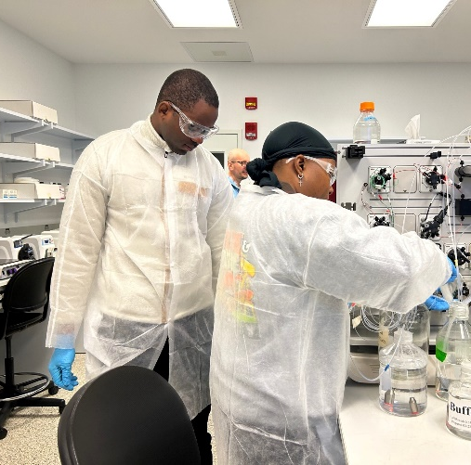

EARN Partnerships by Industry
Healthcare – 23
Biotechnology – 6
Hospitality – 6
Cyber/ Information Technology – 17
Childcare – 3
Clean Energy – 7
Skilled Trades – 14
Manufacturing – 9
Transportation & Logistics – 7
Automotive – 3
Residential Leasing – 2
Education – 1
98 total partnerships

Slide 10
Contact Information
For Questions or to learn more about EARN Maryland:
Mary Keller
Director, Office of Strategic Initiatives
mary.keller@maryland.gov

